Slide 1
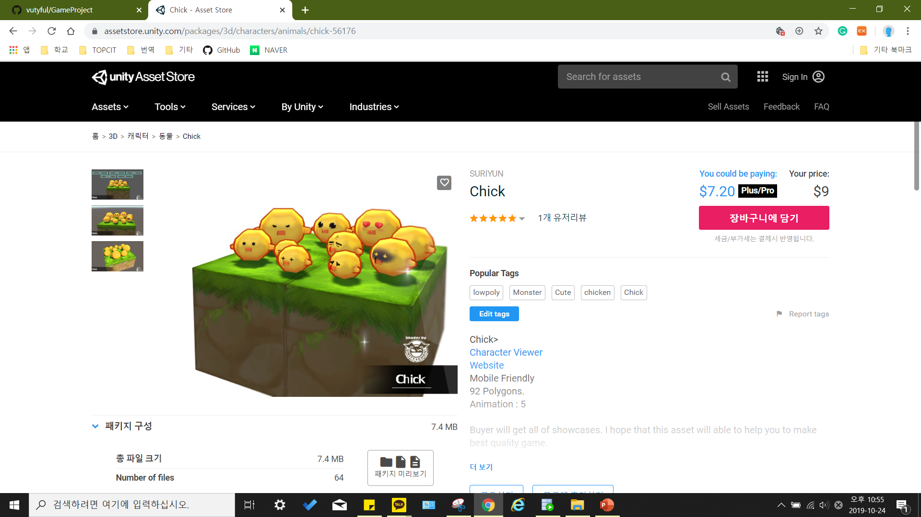
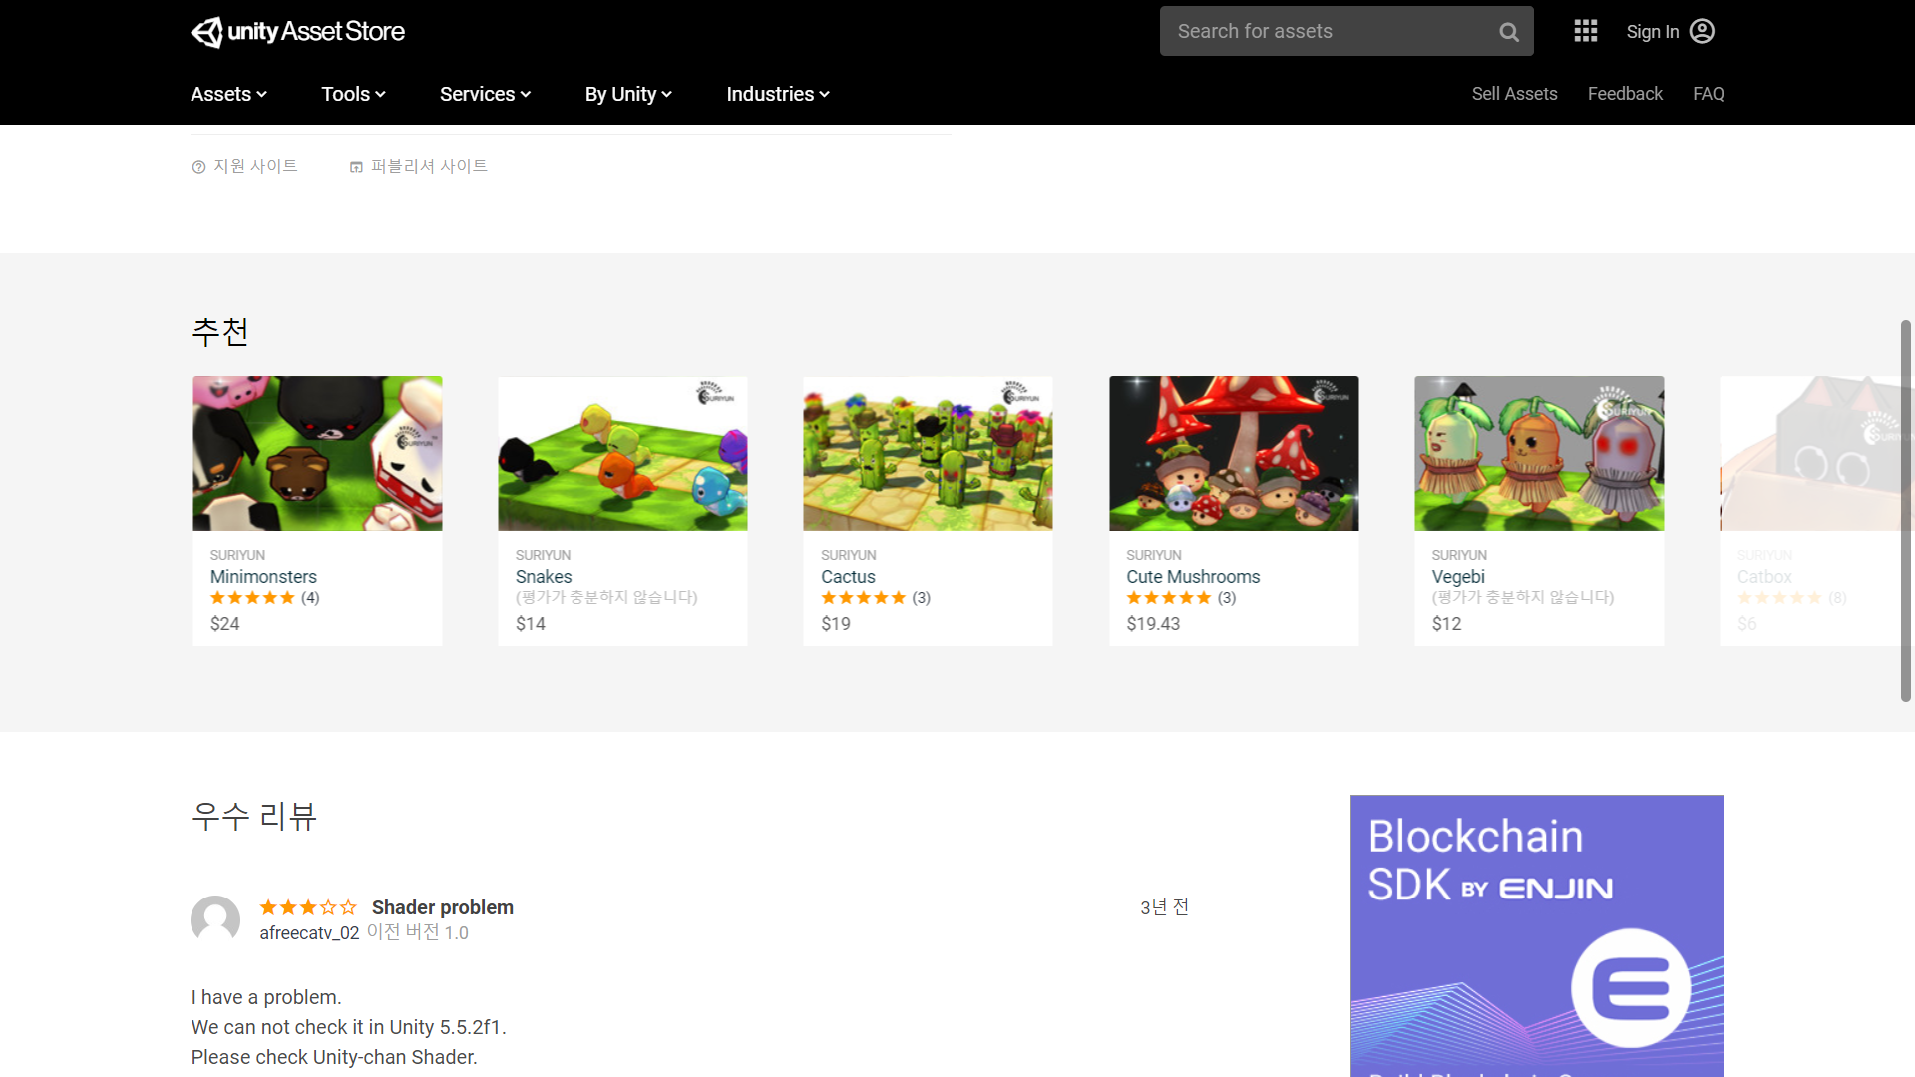
https://assetstore.unity.com/packages/3d/characters/animals/chick-56176

Slide 2
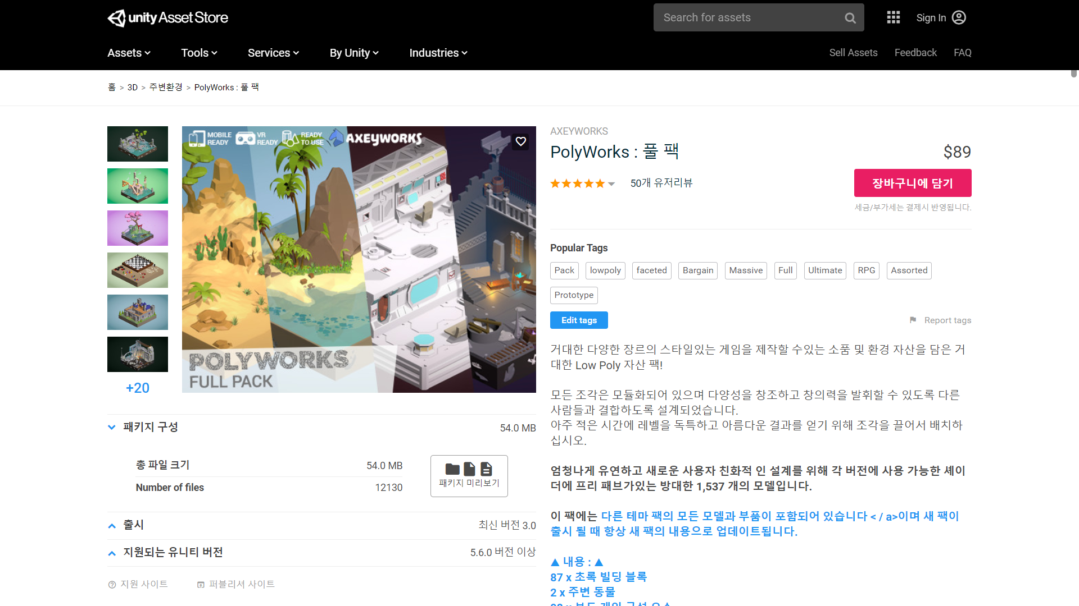
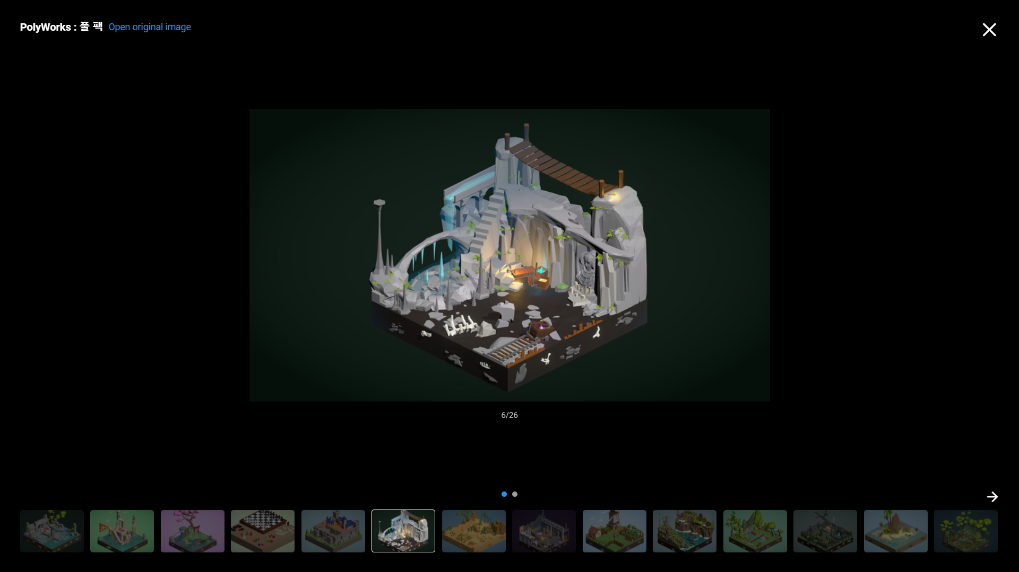
https://assetstore.unity.com/packages/3d/environments/polyworks-full-pack-52666

Slide 3
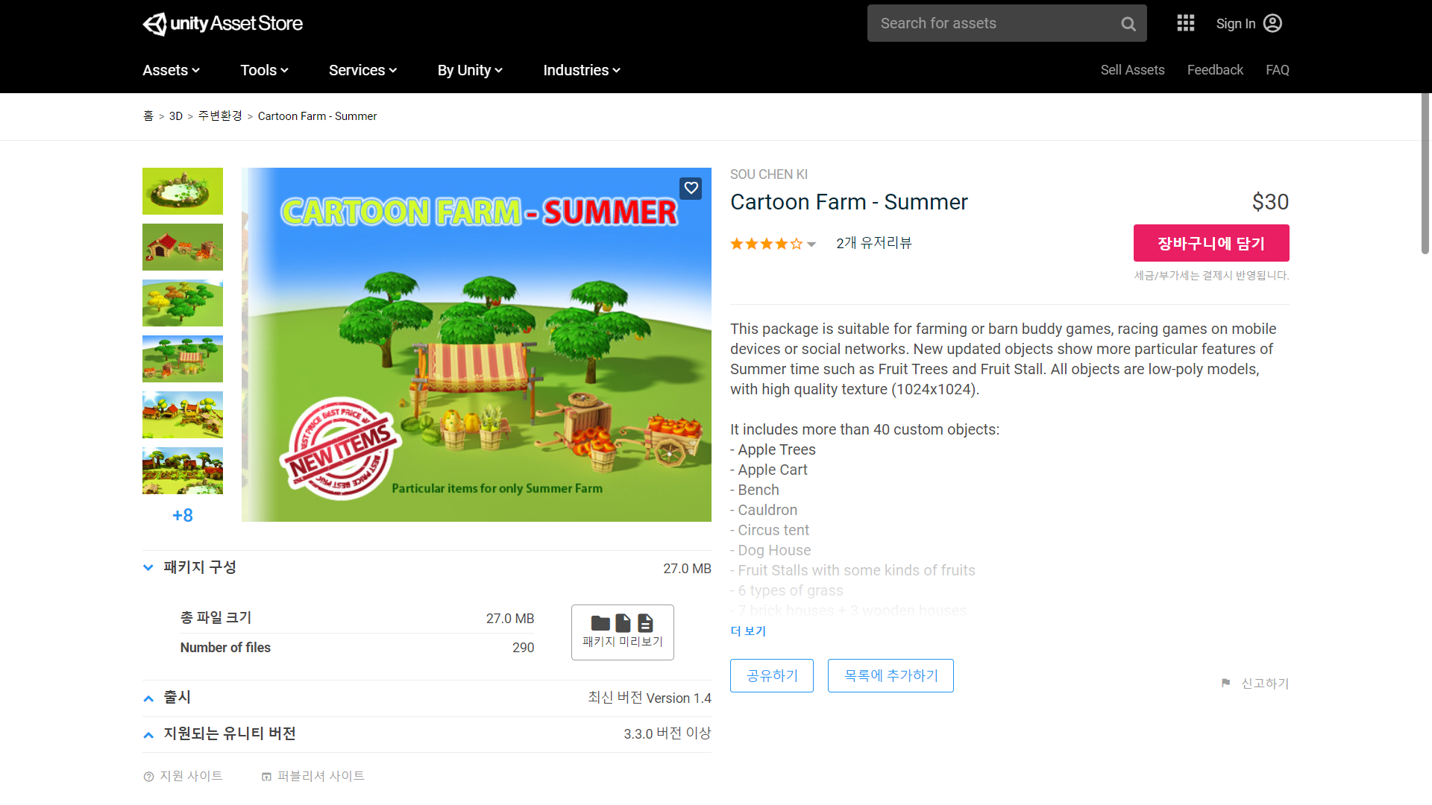
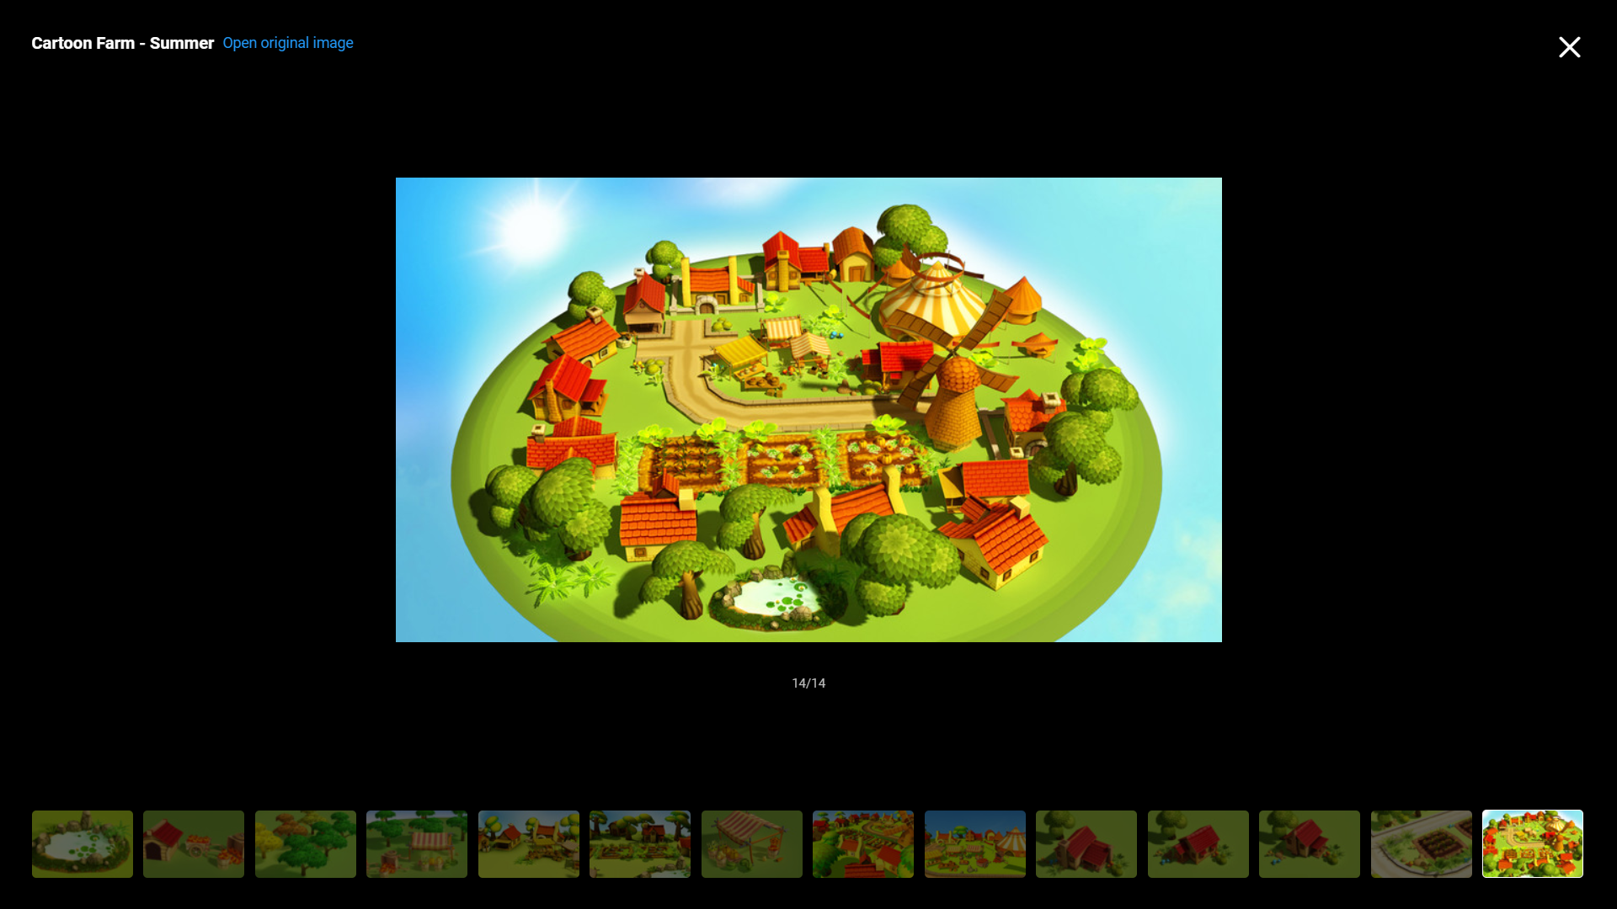
https://assetstore.unity.com/packages/3d/environments/cartoon-farm-summer-6297

Slide 4
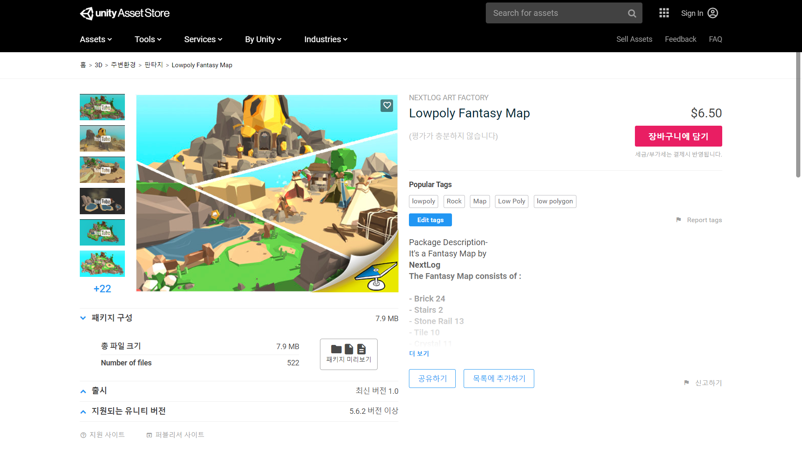
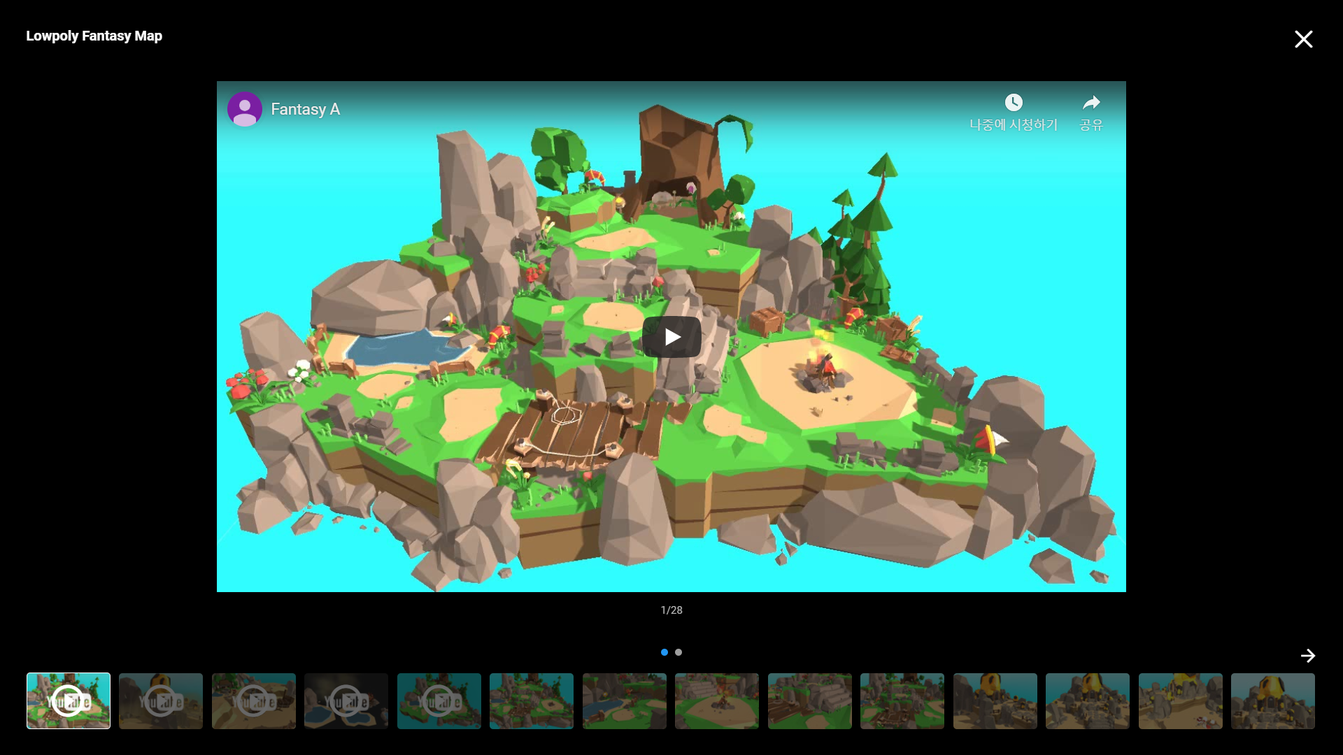
https://assetstore.unity.com/packages/3d/environments/fantasy/lowpoly-fantasy-map-132694

